Slide 1


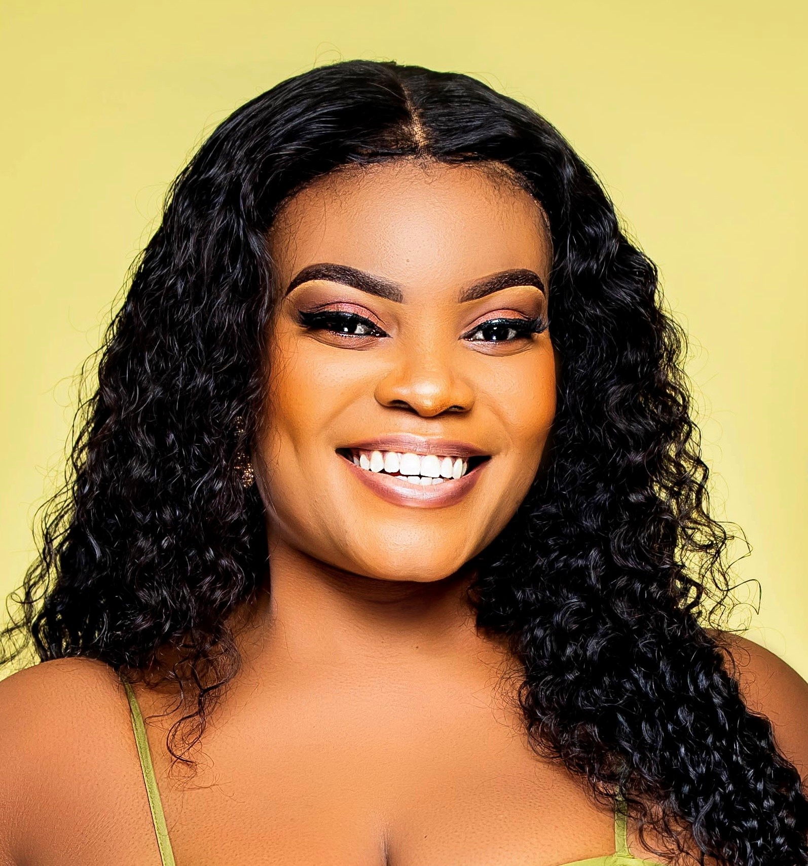
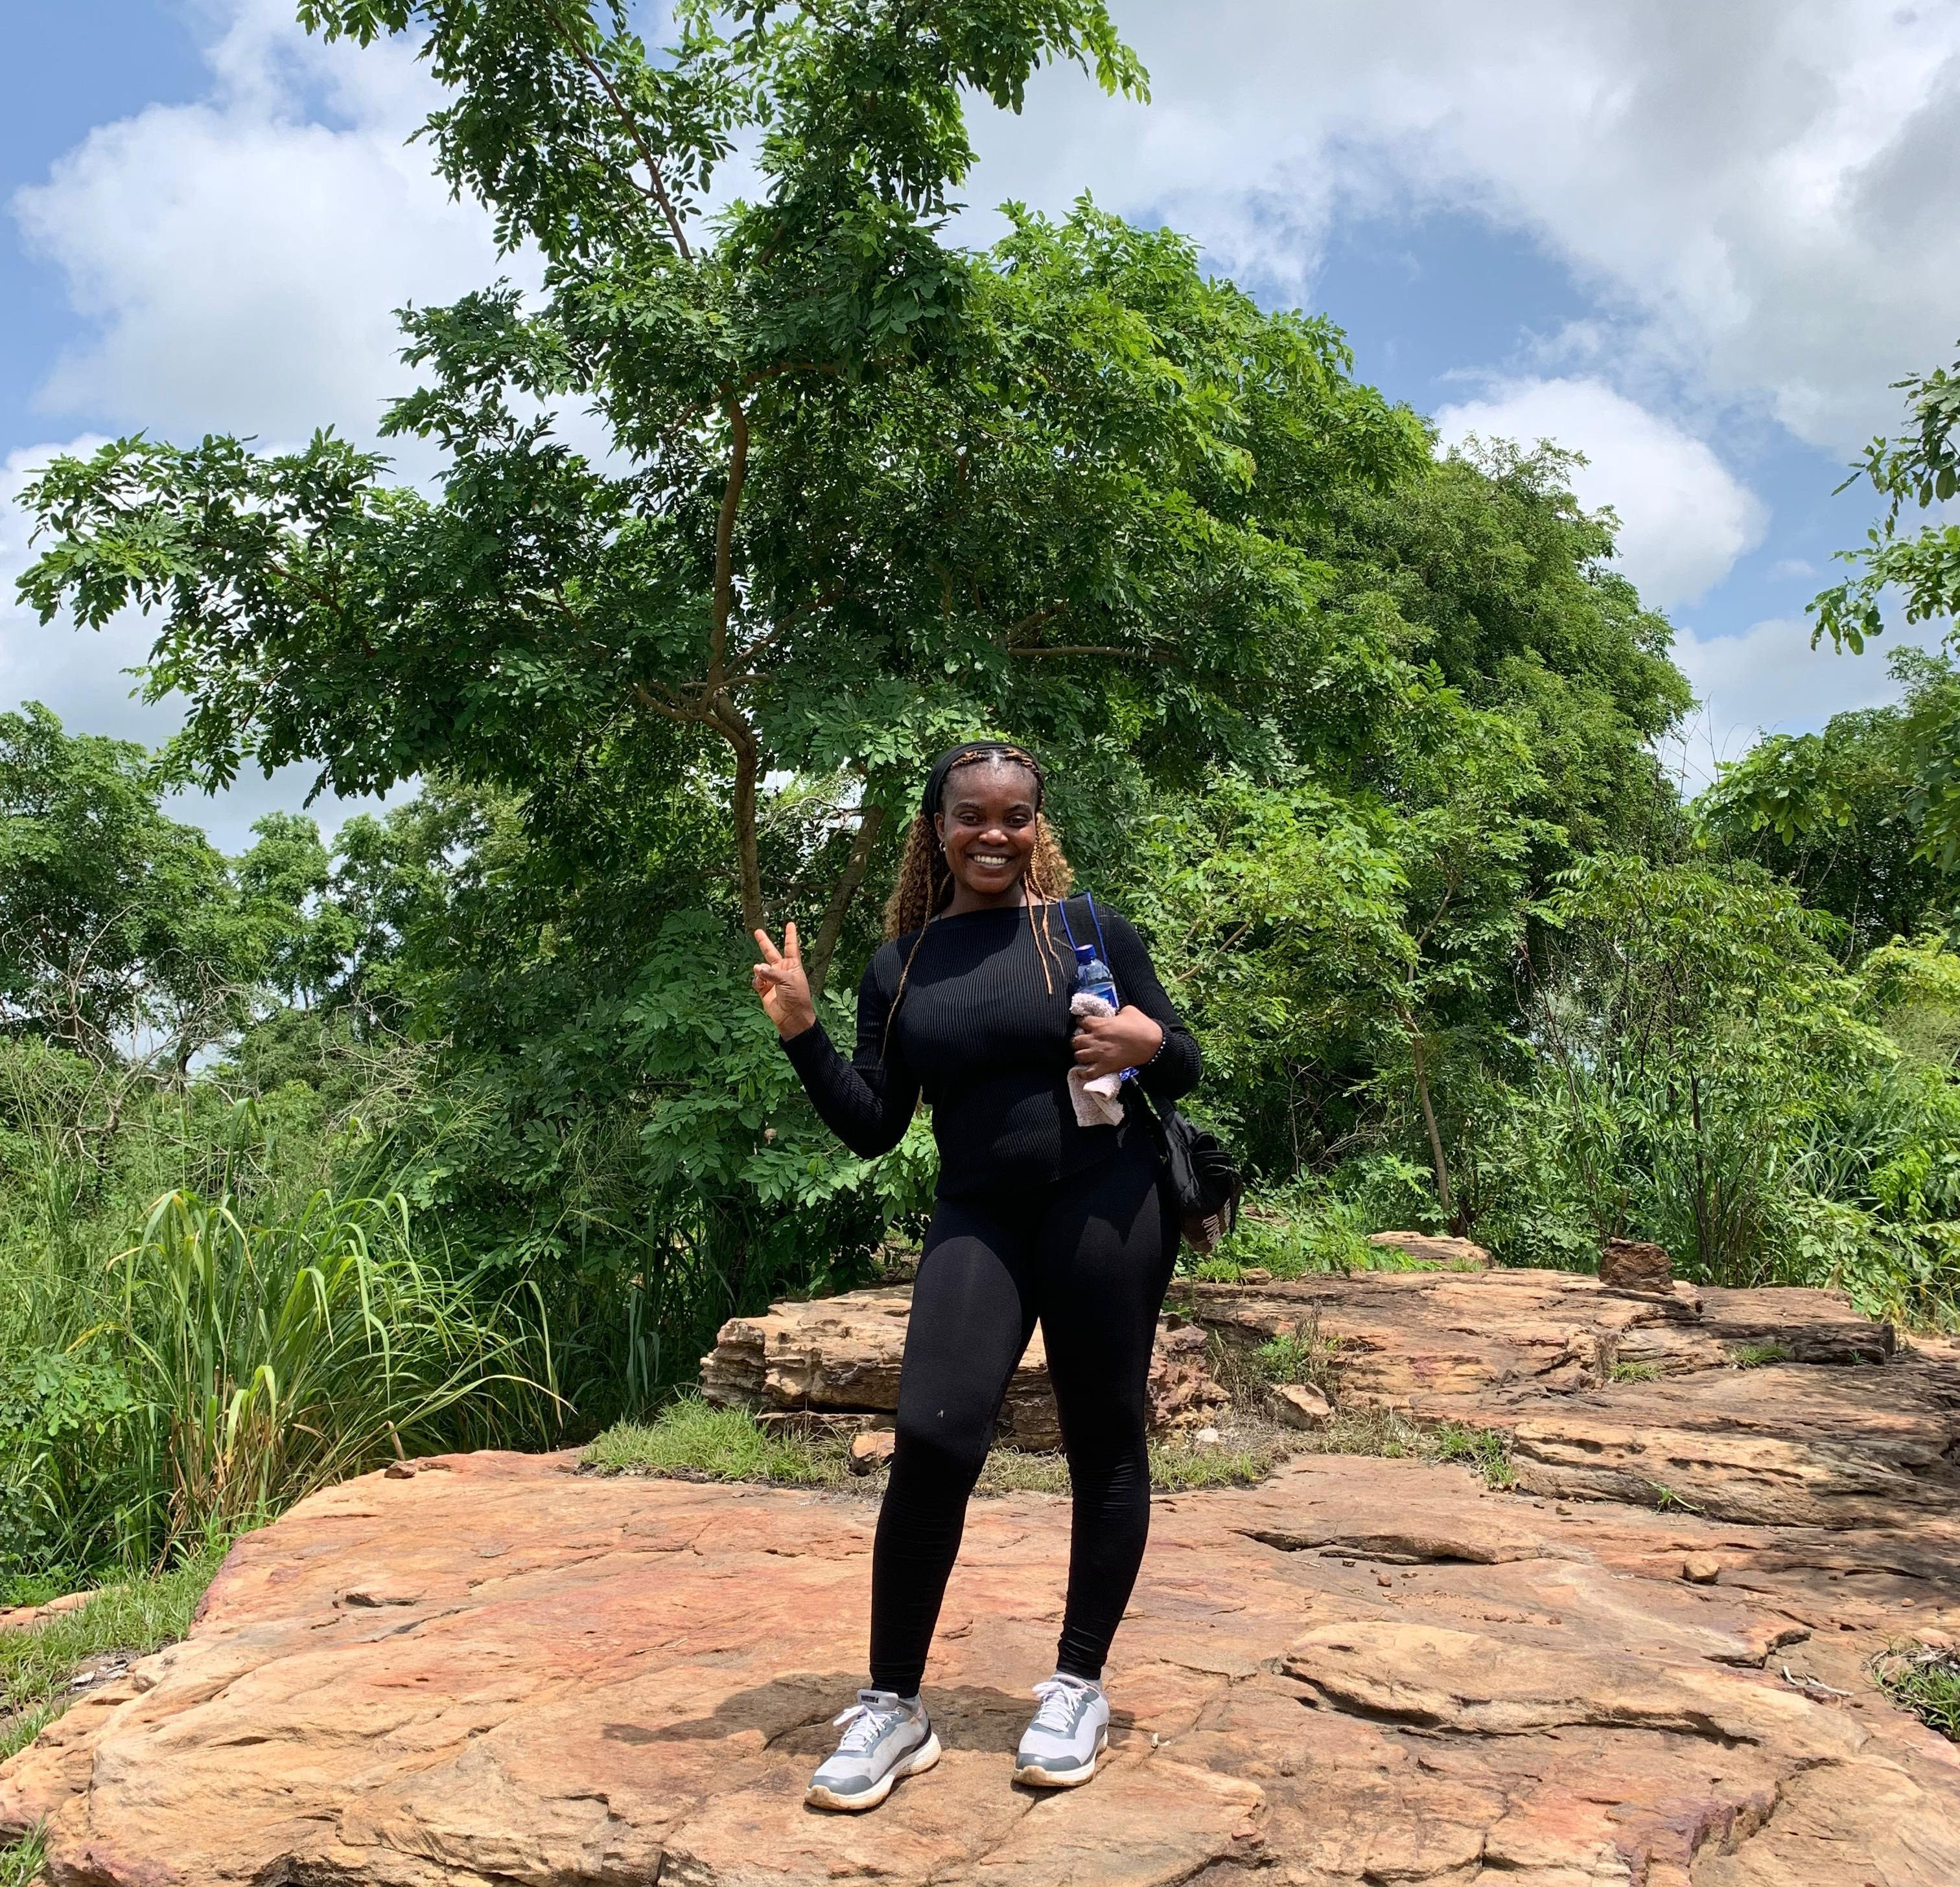
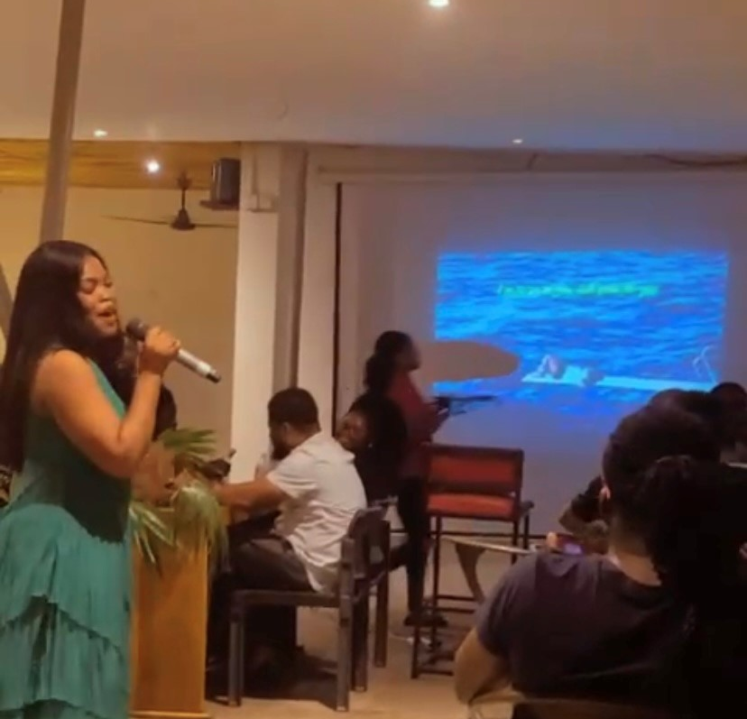
Getting to Know Me
Work
Personal
My role
Data and support officer
Significant others / family members / furry friends in my life
My mother and father
Tenure in ofi/Olam
4 months
How I enjoy spending my free time
Working out, studying, watching movies, dining and going on adventurous trips.
Previous companies I have worked at
Federated Commodities Limited
My favorite / comfort food
Kenkey with fish
Why I joined ofi/Olam and what keeps me here?
The role aligned with my career path and the diversify nature of the company.
My favorite song
Jireh
Lydia Kumah
Lydia’
A few fun facts about me
Curious, passionate and fun
This is me outside work, doing stuff I enjoy in my life …

